Slide 1
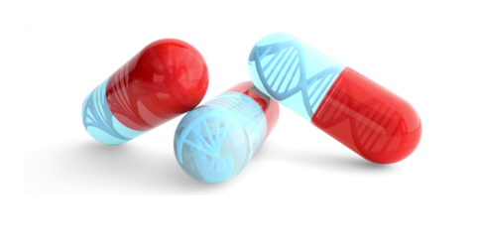


Certificate of Advanced Studies (CAS)
In Personalized Molecular Oncology
Module 3 – Clinical bioinformatics
Day 3 – Emerging technologies
2025.04.11 15h15 – 17h15 | Single-cell RNA-seq analysis Including HANDS-ON on ASAP
Vincent Gardeux
Laboratory of Systems Biology and Genetics (Bart Deplancke)
École Polytechnique Fédérale de Lausanne (EPFL)

Slide 2
Schedule
Lecture on single-cell RNA-seq and analysis: ~1h
Hands-on on a scRNA-seq dataset: ~1h

Slide 3
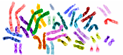
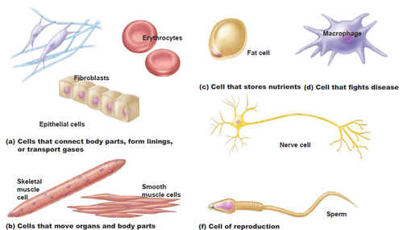
One genome: diverse functional outputs
One genome gives rise to a multitude of different cell types with highly distinct morphologies & functions
1 genome
Remarkable
cellular diversity
and specialisation
Blood cells
Immune cells
Fat cell
Skin
Nerve cell
Muscle
Sperm
anatomyandphysiology.com

Slide 4
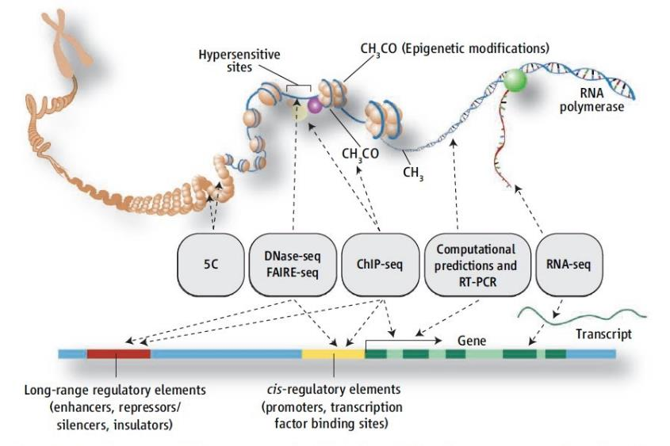

There are multiple genomic layers that can be measured
And
DNA Methylation
Nucleosome position
Chromatin etc.

Slide 5
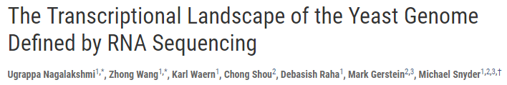
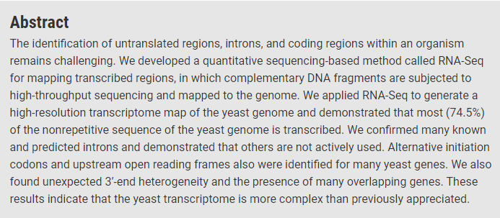
Bulk RNA-seq: estimate gene expression of transcripts in a sample
Bulk RNA-seq estimates expression of gene transcripts in a sample
A major breakthrough in the late 00’s (replaced microarrays)
Nagalakshmi et al, Science 2008

Slide 6
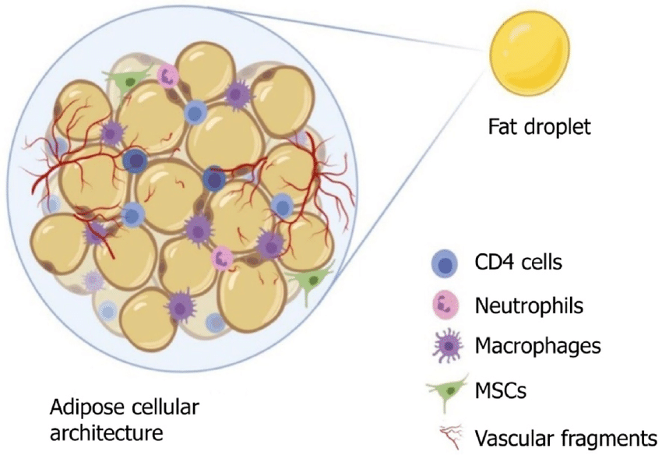
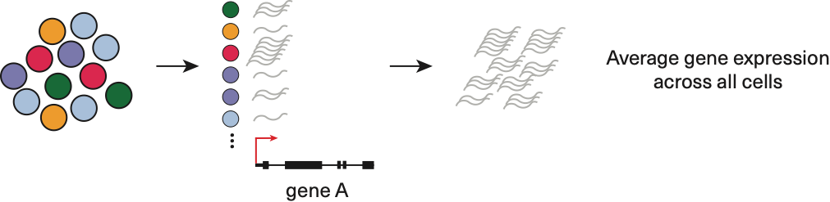
Limitations of bulk RNA-seq
Tissues are generally heterogeneous
Tissue ≠ cell-type
Usually multiple cell-types in a tissue
However, bulk RNA-seq works on large group of cells such as
tissues or cell lines which comprises different cell-types
Cell
Cell
Cell
Cell
Cell
Cell
Cell
Cell
Cell
Cell
Cell
Cell
Sample
Each bulk RNA-seq sample is an AVERAGE transcriptome of many cells
No idea of the distribution of expression levels for each cell, or of the heterogeneity of the sample

Slide 7


Bulk RNA-seq vs single-cell RNA-seq
Each black circle is a cell
Each colored dot is a transcript
Colors encode transcript of the same gene
Macaulay IC, Voet T (2014) PLoS Genet

Slide 8
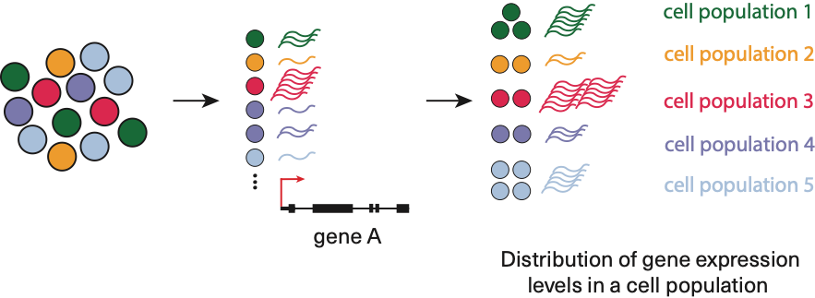
Single-cell RNA-seq (scRNA-seq)
scRNA-seq allows:
Identification of rare cell types (e.g. early development, stem cells, circulating tumor cells)
Studying heterogeneity (e.g. tissue composition, cancer, temporal processes)
Building gene regulatory networks (non-confounded correlations)
Exploring changes in expression while incorporating spatial, regulatory and/or protein information
Single cell phenomena (gene expression stochasticity, mono-allelic expression)
Sample

Slide 9
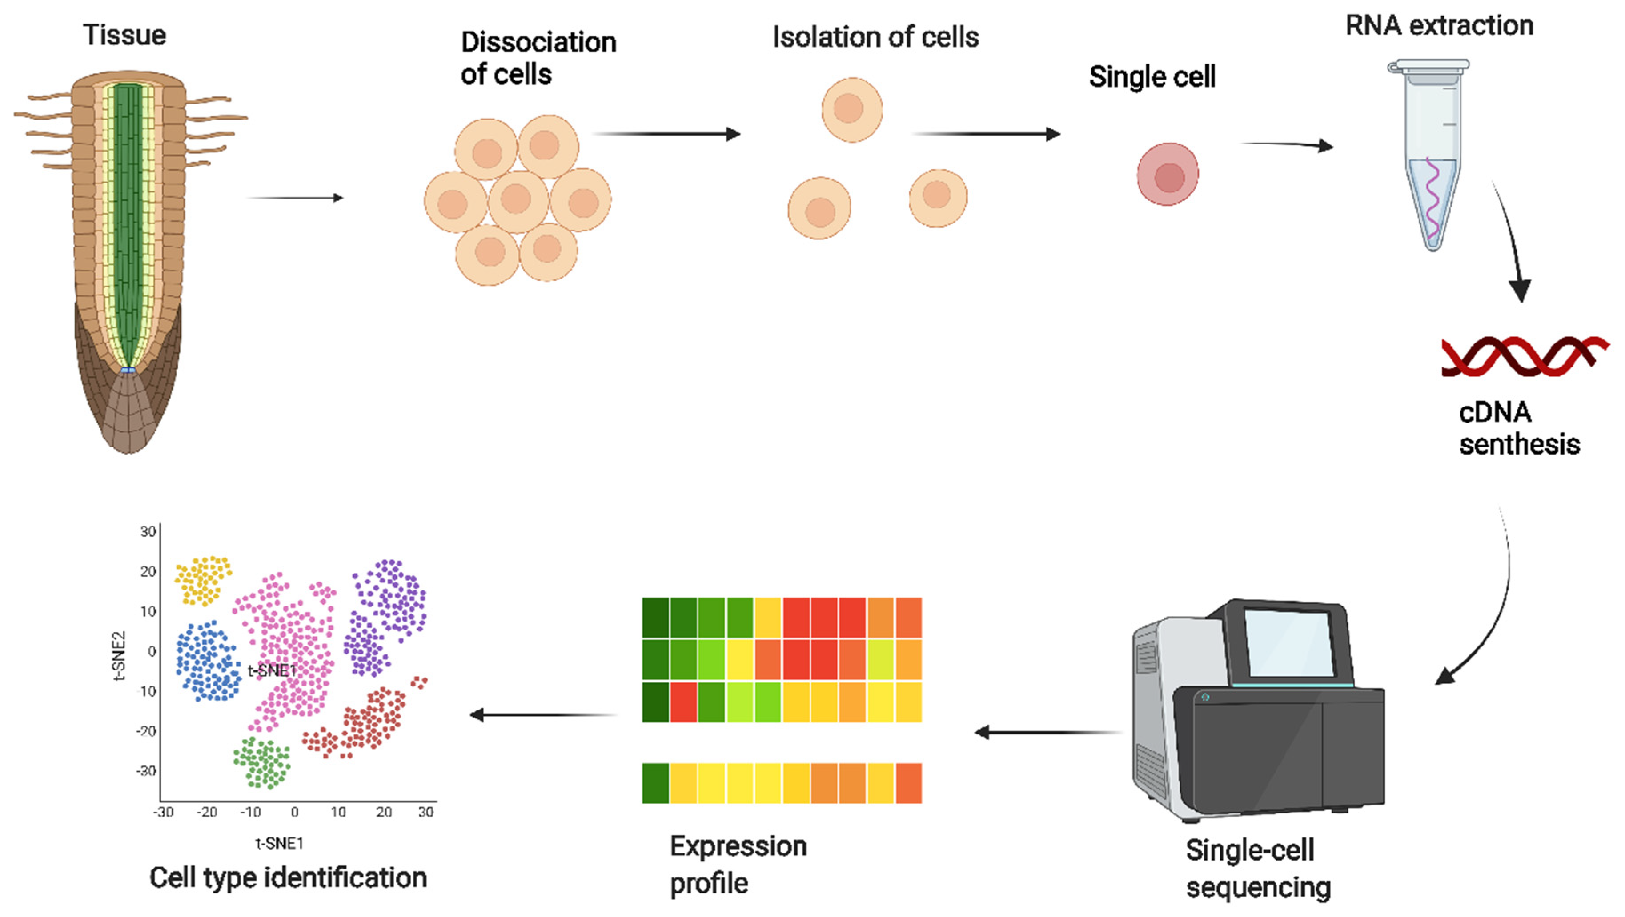
Single-cell RNA-seq experimental workflow
Similar than the bulk RNA-seq workflow, but including additional steps
Dissociation and isolation of cells (for e.g. cell encapsulation in droplets)
Library constructs include UMI and cell-specific barcodes for multiplexing
The data analysis pipeline is also different, as the goal is not only to compare samples together (differential expression), but to explore the sample heterogeneity (cell-type identification, trajectory inference, …)
Bawa et al, IJMS, 2022

Slide 10
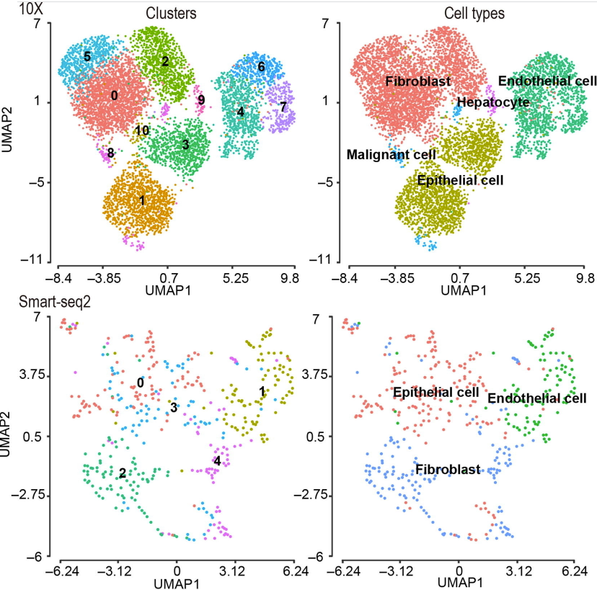
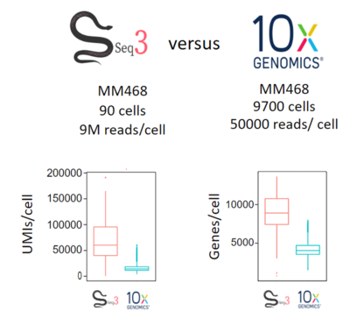
Which protocol to use?
Many protocols exist. The two main ones are 10x and Smart-seq
Currently, the decision is a trade-off between sensitivity and number of cells
Smart-seq is the most sensitive and can process low RNA amounts and low cell numbers / 10x is more accessible & can process more cells, but less sensitive
Pros of using Smart-seq3:
No limit on cell size
No need to keep fresh cells for transport
Full-length transcript information
Cheaper for small-sample sizes
Cons:
Limited number of cells (96- or 384-well plates)
Cell isolation through FACS sorting (or laser microdissection)
Labor-intensive sample prep.
The more cells you study, the better you are able to find and characterize sub populations
X. Wang, Y. He, et al, Genomics, Proteomics & Bioinformatics, 2021

Slide 11
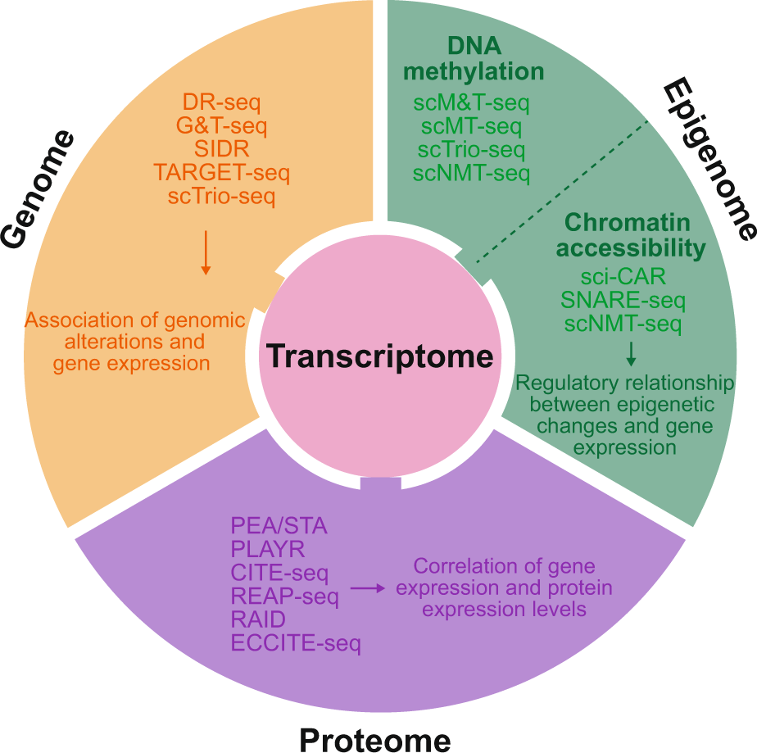

Single-cell multiomics
Single-cell protocols can now assess different genomic layers
DNA methylation
Chromatin accessibility
Proteome
Genome
Some can even be combined in the same cell (multiomics)
DNA & RNA: DR-seq and G&T-seq
Methylation & RNA: scM&T-seq
Chromium single-cell Multiome ATAC + RNA expression
Lee et al, EMM, 2020

Slide 12
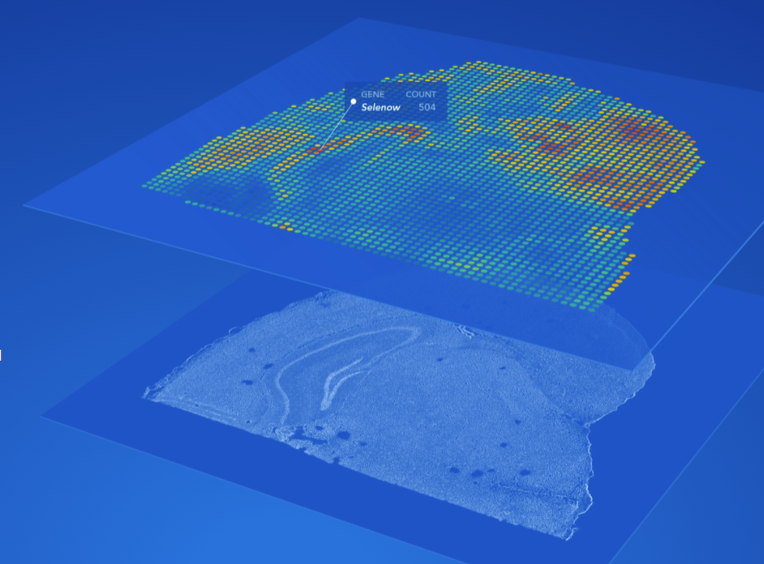
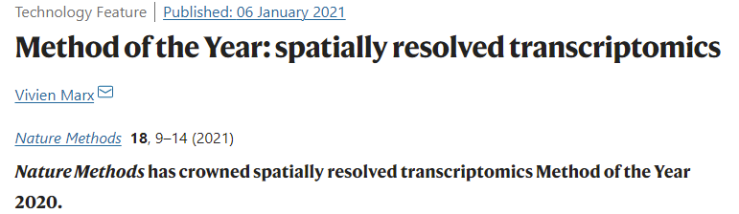

Spatial transcriptomics
Now becomes more and more accessible (commercialized through 10x)
This is not really single-cell anymore (using bins, i.e. multiple cells per bin)

Slide 13


Biologists: “I want to do single-cell”
I finally got good single-cell data!!

Slide 14
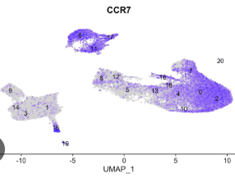

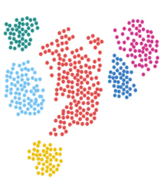
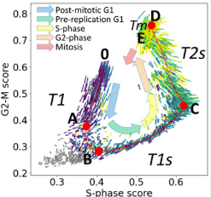
But how do I analyze single-cell data?
How to interpret my data?
What is UMI? How can I find doublets?
What is a PCA? UMAP?
Cell-cycle, ambient RNA, …
…

Slide 15
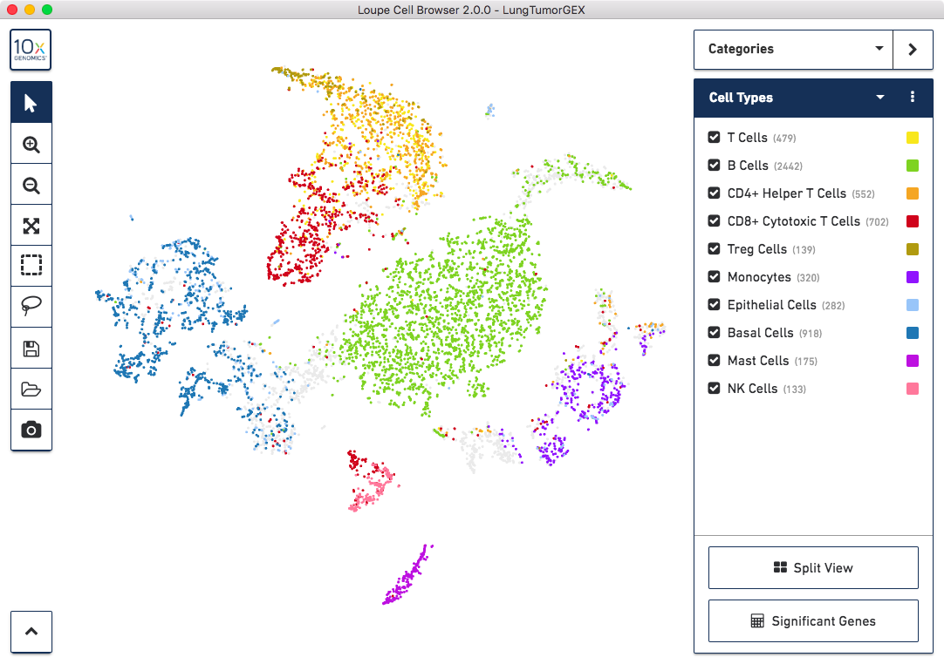


All-in-one analysis pipelines
Cell Ranger + Loupe visualization
Developed for customers of 10x
Black-box fixed pipeline

Slide 16

A scRNA-seq “blackbox” pipeline may not be applicable to all datasets
Preprocessing pipelines are now very standard but downstream analyses can require more hands-on experience
Solutions:
Standardized but parametrizable downstream analysis pipelines (e.g. Seurat, Scanpy)
Probably the best option for bioinformaticians
User-friendly automated analysis and visualization portals (e.g. ASAP, Scope, FastGenomics, etc.)
Good first glance at results for bioinformaticians
Sufficient for non-bioinformaticians
https://satijalab.org/seurat/articles/get_started.html
https://scanpy.readthedocs.io/en/stable/
https://asap.epfl.ch
https://scope.aertslab.org

Slide 17


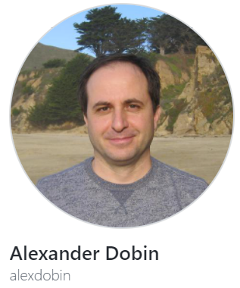




scRNA-seq analysis pipeline
.fastq
Mapping to reference genome
Single-cell specific:
Barcode demultiplexing
UMI counting
Filtering of cells (e.g. empty droplets, …)
Demultiplexing and
Quality Control (QC)
UNIX / Bash
.bam
PREPROCESSING
.txt / .csv
.h5 / .loom
Read / transcript matrix
(raw counts / UMI)
QC and filtering
Single-cell specific:
Filtering doublets, ambient RNA
Removing covariates (cell-cycle)
Integrating multiple datasets
Seurat or Scanpy objects
Normalization, noise removal, PCA
R / Python / Web
DOWNSTREAM ANALYSIS
Study-specific downstream analysis

Slide 18
Downstream analysis pipeline
.fastq
Mapping to reference genome
Single-cell specific:
Barcode demultiplexing
UMI counting
Filtering of cells (e.g. empty droplets, …)
Demultiplexing and
Quality Control (QC)
UNIX / Bash
.bam
PREPROCESSING
.txt / .csv
.h5 / .loom
Read / transcript matrix
(raw counts / UMI)
QC and filtering
Single-cell specific:
Filtering doublets, ambient RNA
Removing covariates (cell-cycle)
Integrating multiple datasets
Seurat or Scanpy objects
Normalization, noise removal, PCA
R / Python / Web
DOWNSTREAM ANALYSIS
Study-specific downstream analysis

Slide 19
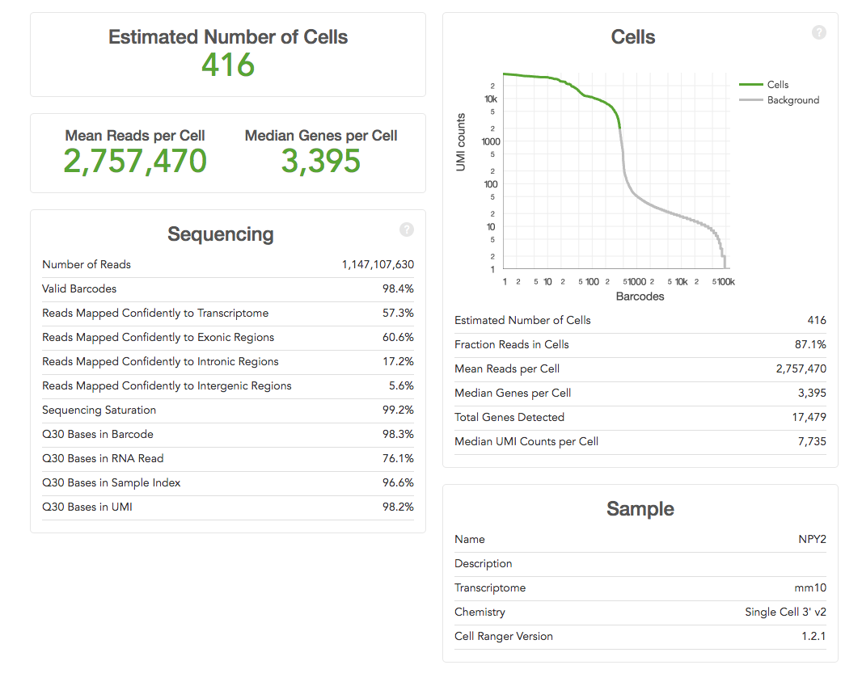
Quality control (post-alignment)
Number of Cells
Removal of empty droplets
Alignment quality
Number and fraction of mapped reads
Mapping to exonic regions (check for gDNA contamination)
Number of detected genes/cell
Where do the reads map? Introns/Exons/Intergenic
Check for stressed cells, dead cells, ribosomal/mitochondrial contamination
Ratio Mitochondrial/Ribosomal/Protein-Coding
Goal: Hunt for aberrant low quality cells to filter out because they may bias the downstream results
Example 10x – CellRanger report

Slide 20
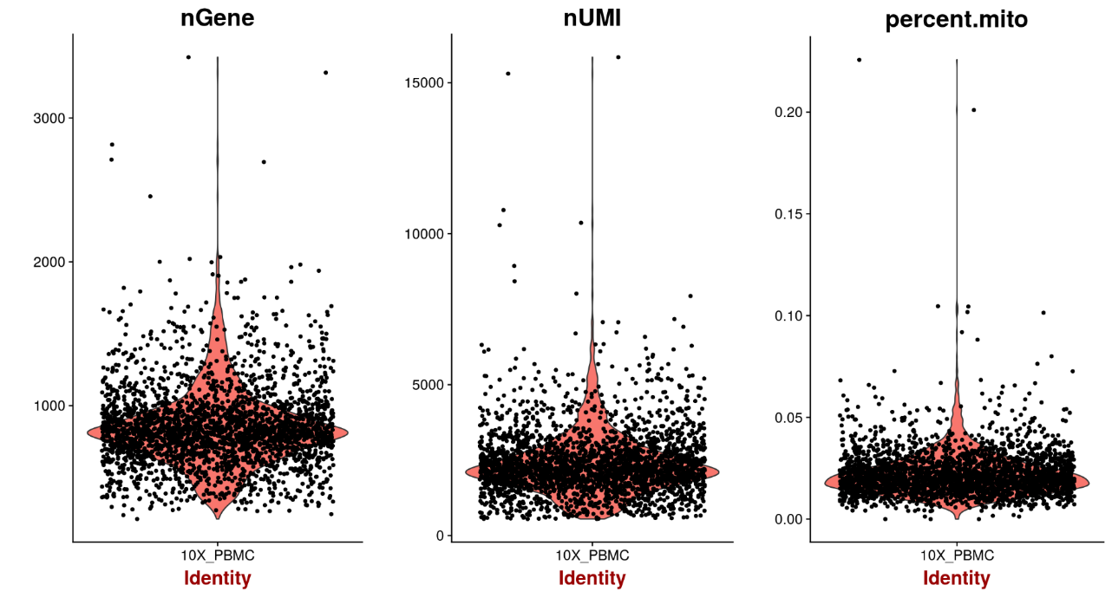
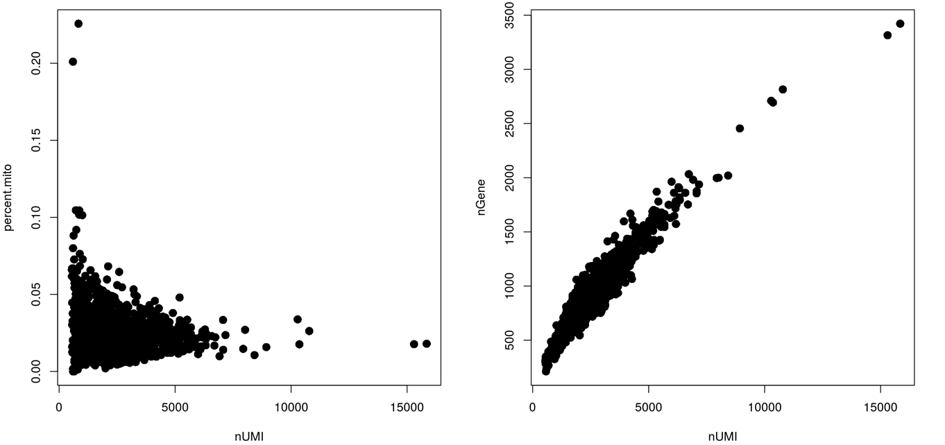
Cell Filtering
Low number of expressed genes / cell can indicate low quality cells (e.g. degraded RNA)
Remove such cells
“Low” is arbitrary, and depends on protocol and cell types
Low values can sometimes be biologically meaningful, so be careful when filtering
Usually: Apply a very lenient filtering first, then check the UMAP (colored by tech. features)
VlnPlot() in Seurat
FeatureScatter() in Seurat

Slide 21
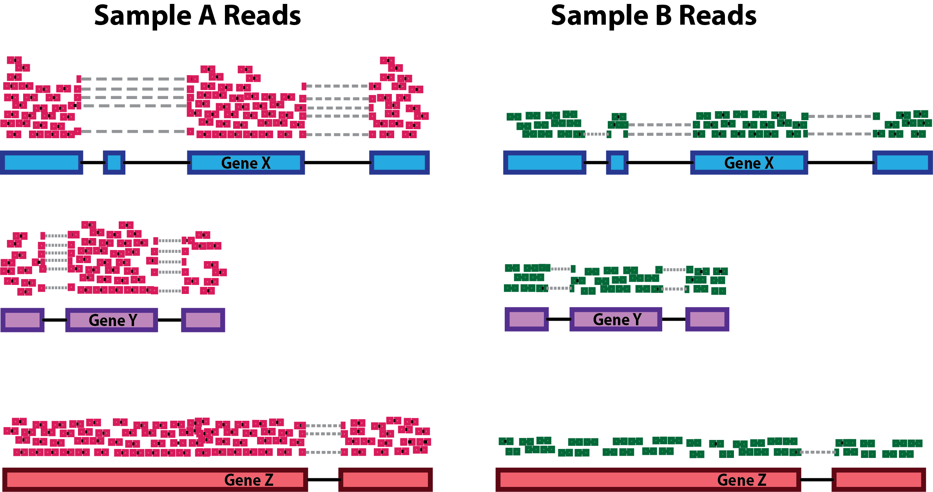
Normalization
Expression values typically need to be normalized to make samples comparable.
Why?
Mainly to remove sequencing depth bias (total read count per cell)
Gene length bias (if using a full transcript protocol instead of 3’ based protocol)
Which normalization to use?
Usually, pipelines use a simple Count Per Million (CPM) normalization (or with different scaling factors (1E6 for CPM, sometimes 1E4)
Then, the data is log₂(1 + x)transformed (or log / log₁₀) depending on the pipeline)
Sequencing depth bias: Gene Y is more expressed in Cell A than B?

Slide 22
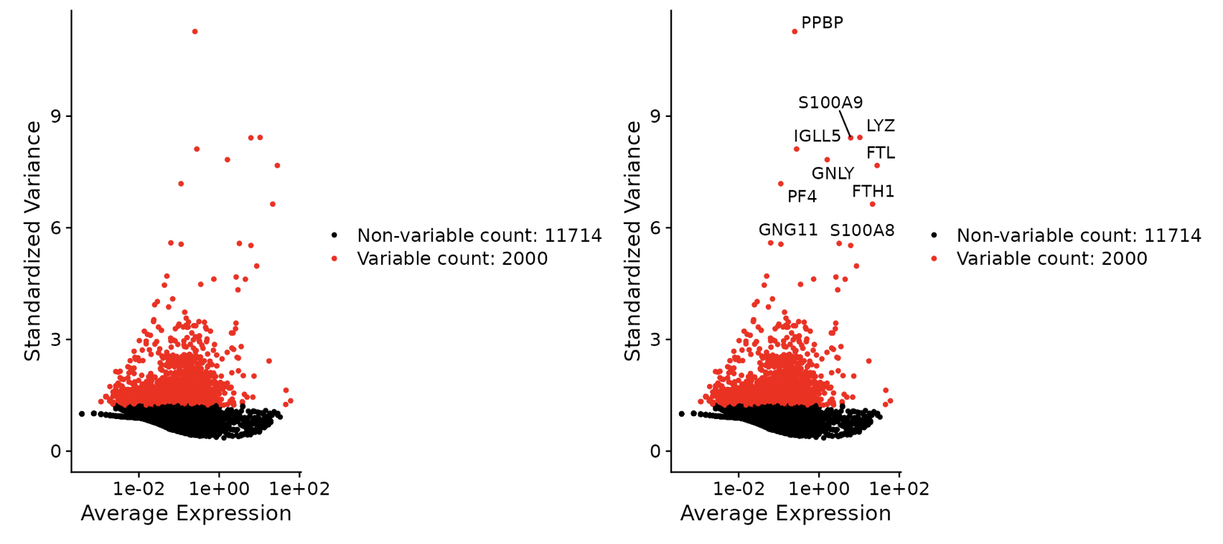
Highly Variable Genes
Identification of highly variable genes exhibiting high cell-to-cell variation in the dataset
Focusing on these genes in downstream analysis helps to highlight biological signal in single-cell datasets
https://satijalab.org/seurat/articles/pbmc3k_tutorial.html

Slide 23
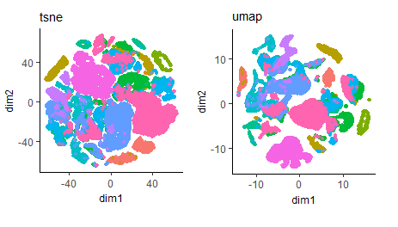


Dimensionality reduction
Goal: Find two axis (data projections) that maintain relations between cells as best as possible
In scRNA-seq, it is used to group cells by transcriptomic similarity, and display them in a two-dimensional space
 | Cell 1 | Cell 2 | …
Gene 1 | 25 | 918 | …
Gene 2 | 0 | 456 | …
… | … | … | …
Gene n | 103 | 180 | …
Single-cell gene expression matrix
PCA / t-SNE / UMAP / …
~10k-20k D
2D, 3D or 4D….

Slide 24
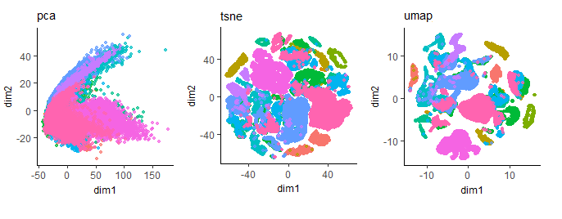
PCA with scRNA-seq, a preprocessing step
With single-cell data, PCA often struggles to resolve the heterogeneity of the data using only 2 dimensions. So we don’t use it for visualization
Stochastic dimension reduction methods are used instead: t-SNE or UMAP
UMAP (ran on PCA embeddings)
Equally good or perhaps better resolution compared to t-SNE
It also preserves better the global structure of the data (still not fully reliable) and runs faster than t-SNE
Currently the most-used dimension reduction method
@Towards Data Science

Slide 25

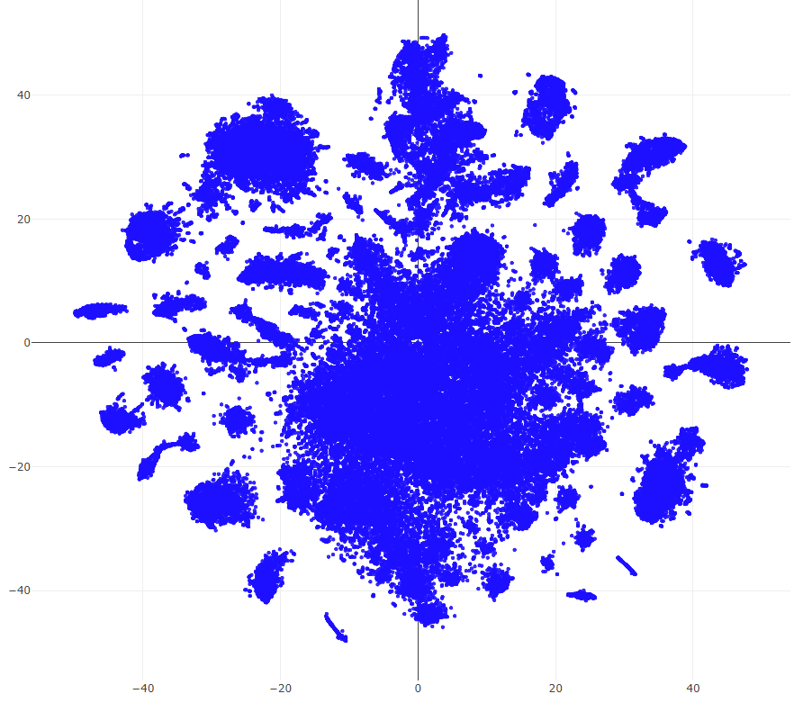
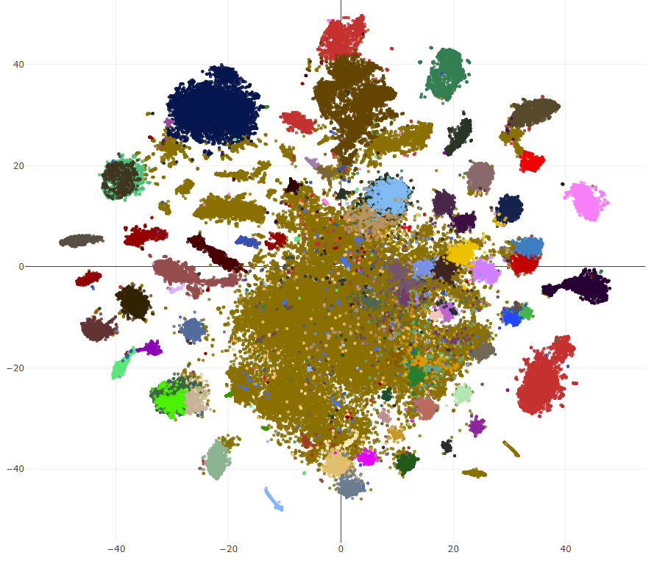
Clustering
Student λ: Why this step is mentioned again?
Question: Did we see clustering methods before?
UMAP / t-SNE are NOT clustering methods
≠
t-SNE
Clustering

Slide 26
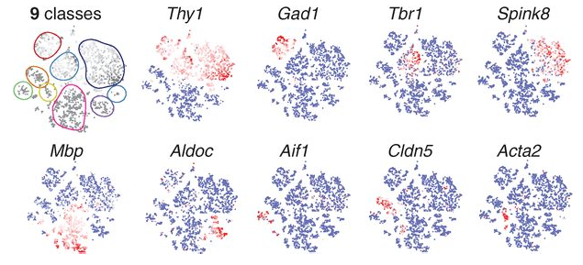
Clustering
Motivation: Dimension reduction allows to extract the most informative components and visualize cells, but how to automatically set boundaries between the individual cells? Systematic grouping into types?
Usage: Usually runs on the PCA components

Slide 27
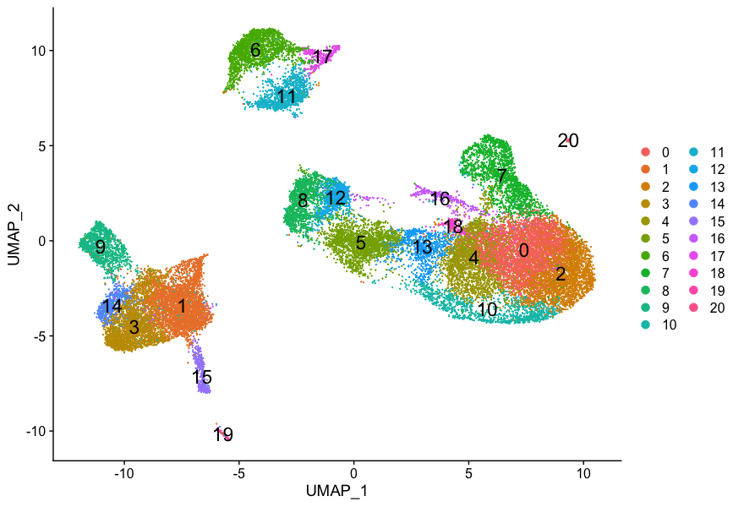
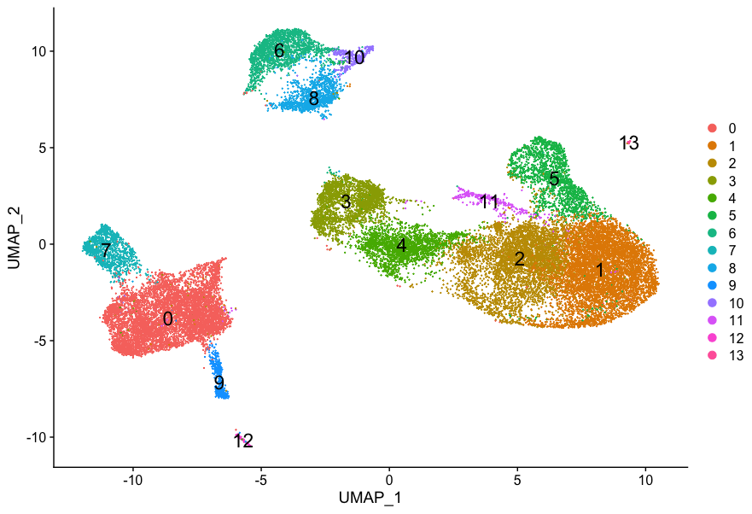
What clustering method, and how to use them
Most efficient single-cell RNA-seq clustering methods are graph-based (Louvain, Leiden)
They rely on parameters that need to be tuned (e.g. resolution). How?
In a nutshell: It’s super arbitrary
Default Seurat resolution = 0.8
Seurat resolution = 0.4
https://hbctraining.github.io/scRNA-seq/lessons/07_SC_clustering_cells_SCT.html

Slide 28
Finding marker genes of different clusters
Question:
I have 3 groups/clusters of cells (A,B,C)
I need to find marker genes for group B (i.e. genes that are more expressed in B, than A and C => cell-type specific expression)
What method could I use?

Slide 29
Differential Expression (DE) analysis
Goal: identification of genes (or transcripts, exons, …) that are expressed in significant different quantities in distinct groups
e.g. drug-treated vs control, disease vs healthy, cell-types, tissues, development stages, ...
What method to use for doing that?
Mostly statistical tests (Wilcoxon test, t-test, etc…)
Why not simply using fold-change (FC)?
Many FP or FN would be expected, because does not take into consideration:
Low expressed genes that will tend to have higher FC (vs High)
The distribution of the data (inherent variance of gene expression)

Slide 30
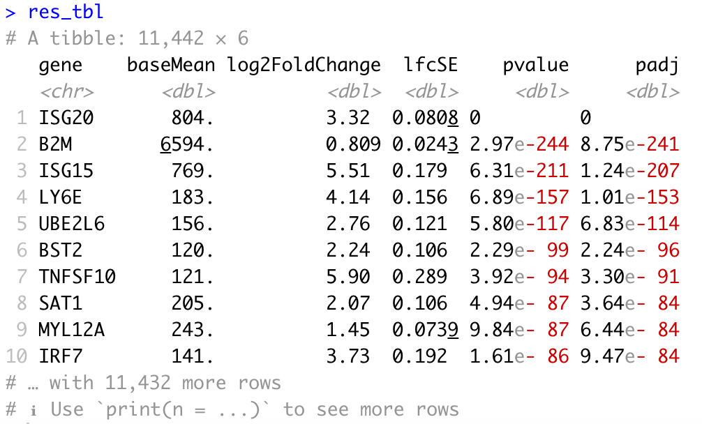
Typical output of DE method
Questions:
Do you understand all columns?
How is this sorted? Why?
Would you sort it differently?
Usually, in single-cell RNA-seq datasets, this is run for each cluster, to find its marker genes.
With Group1 = Cluster, and Group2 = All other cells.

Slide 31
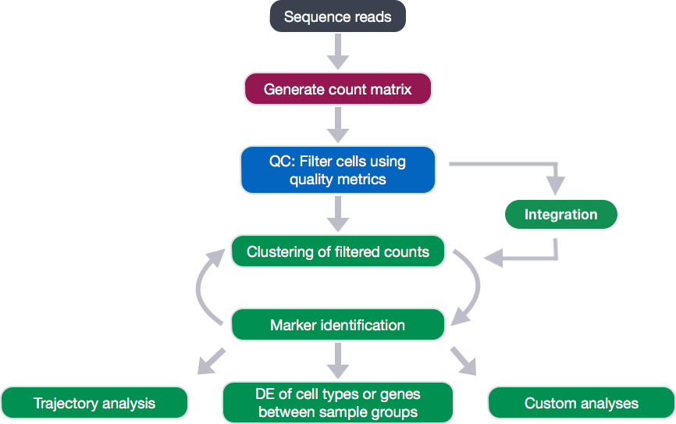
Final analysis pipeline looks like this
Preprocessing
Normalization, HVG, PCA
Downstream analyses
https://hbctraining.github.io/scRNA-seq/lessons/07_SC_clustering_cells_SCT.html

Slide 32
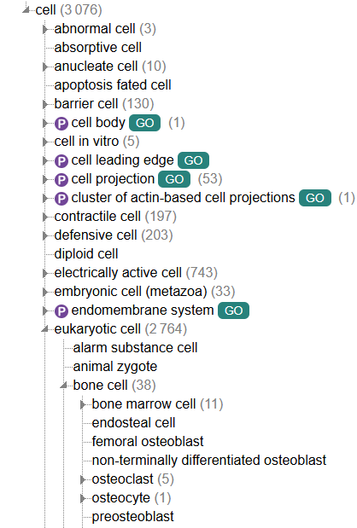
Cell type annotation
Usually the most labor-intensive task
Cell type depends on species / tissue / conditions / …
Cell types can be found in multiple tissues and may perform different roles in different tissues
Cell type (more stable) ≠ cell state (more transient), but it may be difficult to distinguish the two
Cell types can be broad (neuron) or more specialized (sensory neuron), so annotator/curator needs to set some annotation levels (broad or precise)
There are specific ontologies that describe tissues/cell-type as graphs or trees (UBERON, Cell Ontology, …)
https://www.ebi.ac.uk/ols4/ontologies/cl

Slide 33
What methods to use?
There are a few options
Use marker genes and experts knowledge / litterature and manually curate all clusters
Use marker genes and cell-type databases (e.g. PanglaoDB) and perform functional enrichment analysis (Enrichr, topGO, …)
Using a prediction model trained on reference markers (e.g. Garnett)
Use a reference dataset/atlas to transfer annotations or integrate datasets together e.g.
Label transfer using Seurat
Supervised integration using scANVI
Cross-species integration and label transfer using SAMap or SATURN
Using cloud-based service such as cellranger annotate (cellranger v9 – Feb 6, 2025)
Using LLM-based prediction using AnnDictionary, GPTCelltype , …
Marker-based
Reference-based

Slide 34
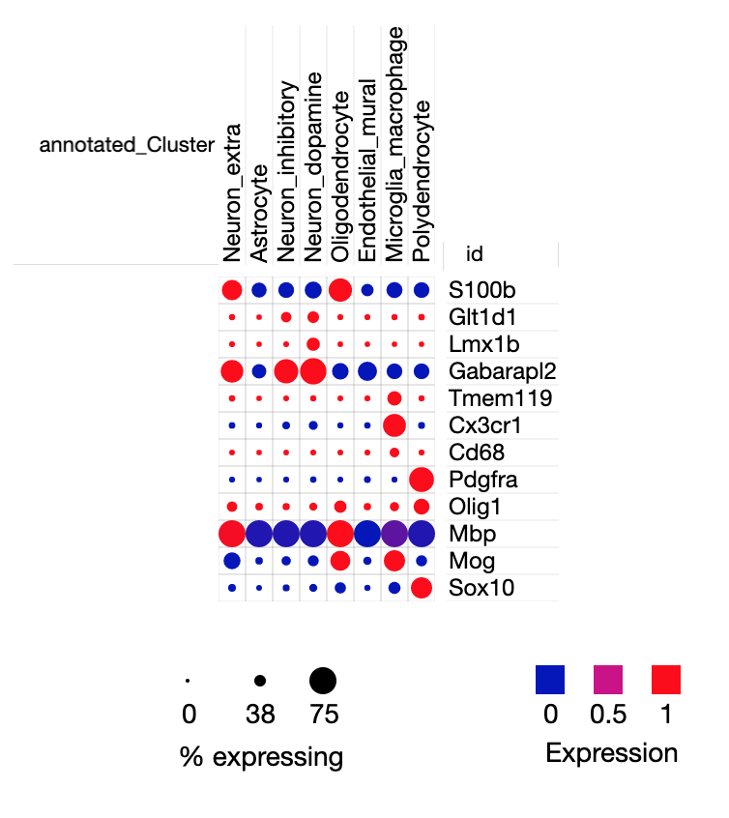
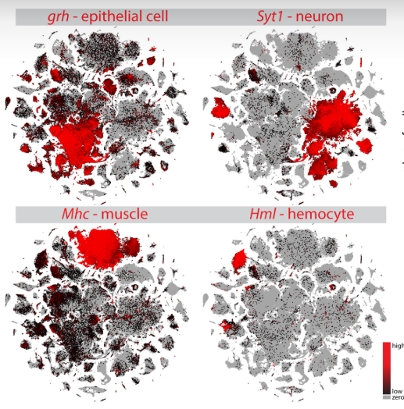
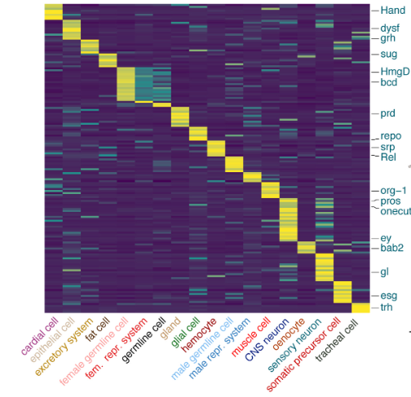
Visualization
Standard plots to know
Heatmap of top DE genes /
Marker genes
Dotplot
Marker gene expression

Slide 35
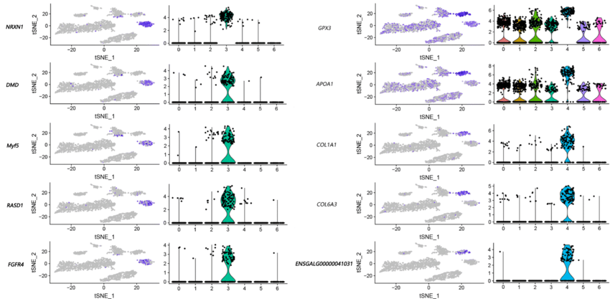
Visualization
Standard plots to know
Marker gene expression on UMAP/t-SNE + violin plots
Li et al, BMC Genomics, 2020

Slide 36
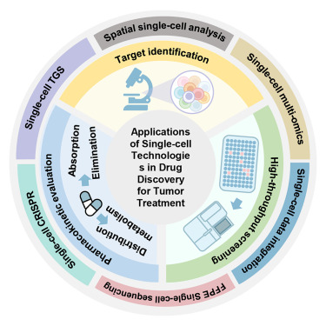
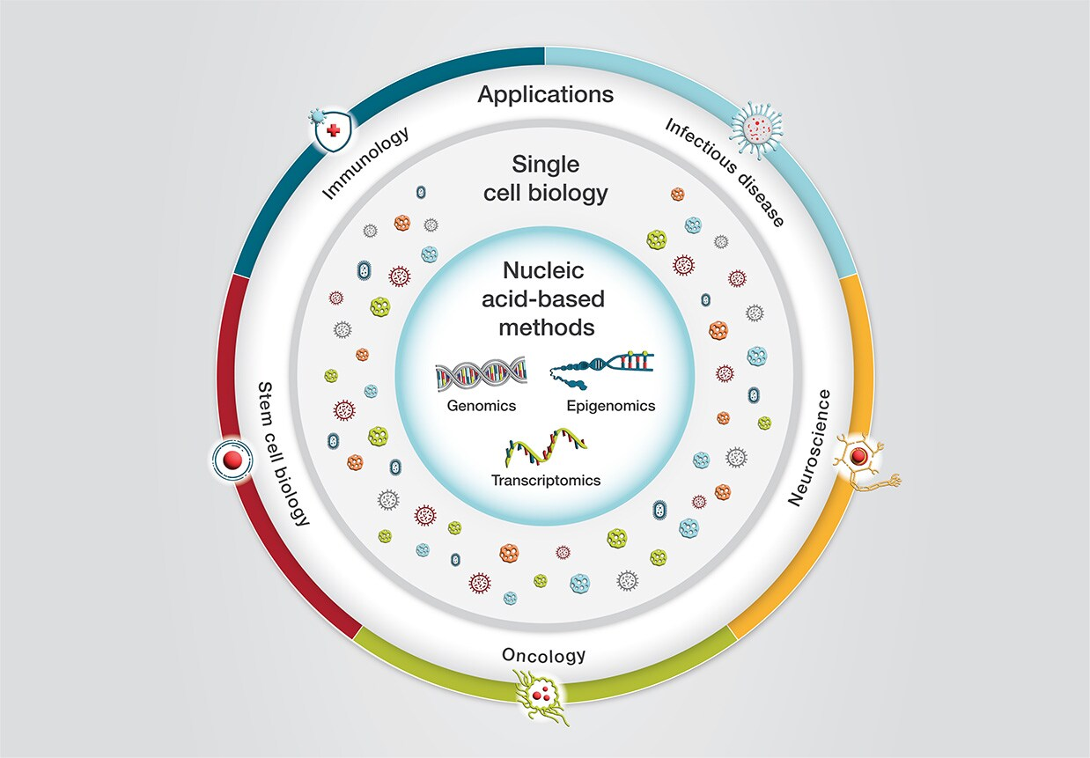
Single-cell omics, future and applications
Single-cell omics is more and more democratized and now applied to a wide variety of fields and application
We saw single-cell RNA-seq, but there are many other technologies:
Single-cell epigenomics, proteomics, metabolomics
Spatial transcriptomics, metabolomics, proteomics
Single-cell multiomics aggregating multiple omics layers from the same cell (e.g. ATAC-seq + RNA-seq)
Cell atlas consortiums are generating very big reference atlases (e.g. Human Cell Atlas)
Still developing field: new technologies (spatial transcriptomics, perturb-seq, …) may overcome current single-cell RNA-seq limitations
Methodology-wise: LLMs are now taking over to model different biological mechanisms based on these ever-growing datasets.
scGPT, a generative AI-based methods for clustering / cell annotation, etc..
Liu et al, iScience, 2024
Thermofisher

Slide 37
Complementary reading
Oncology
Chang X. et al., Single-Cell RNA Sequencing: Technological Progress and Biomedical Application in Cancer Research, Molecular Biotechnology, 2023
Boxer E. et al., Emerging clinical applications of single-cell RNA sequencing in oncology, Nature reviews clinical oncology, 2025
Ren et al., Single cell RNA sequencing for breast cancer: present and future, Nature Cell Death Discovery, 2021
Others
Cui H., et al, scGPT: toward building a foundation model for single-cell multi-omics using generative AI, Nature methods (2024)
Ando, Y. et al. An era of single-cell genomics consortia. Exp Mol Med 52, 1409–1418 (2020)
Edsgärd, D et al, Identification of spatial expression trends in single-cell gene expression data. Nat Methods 15, 339–342 (2018)

Slide 38
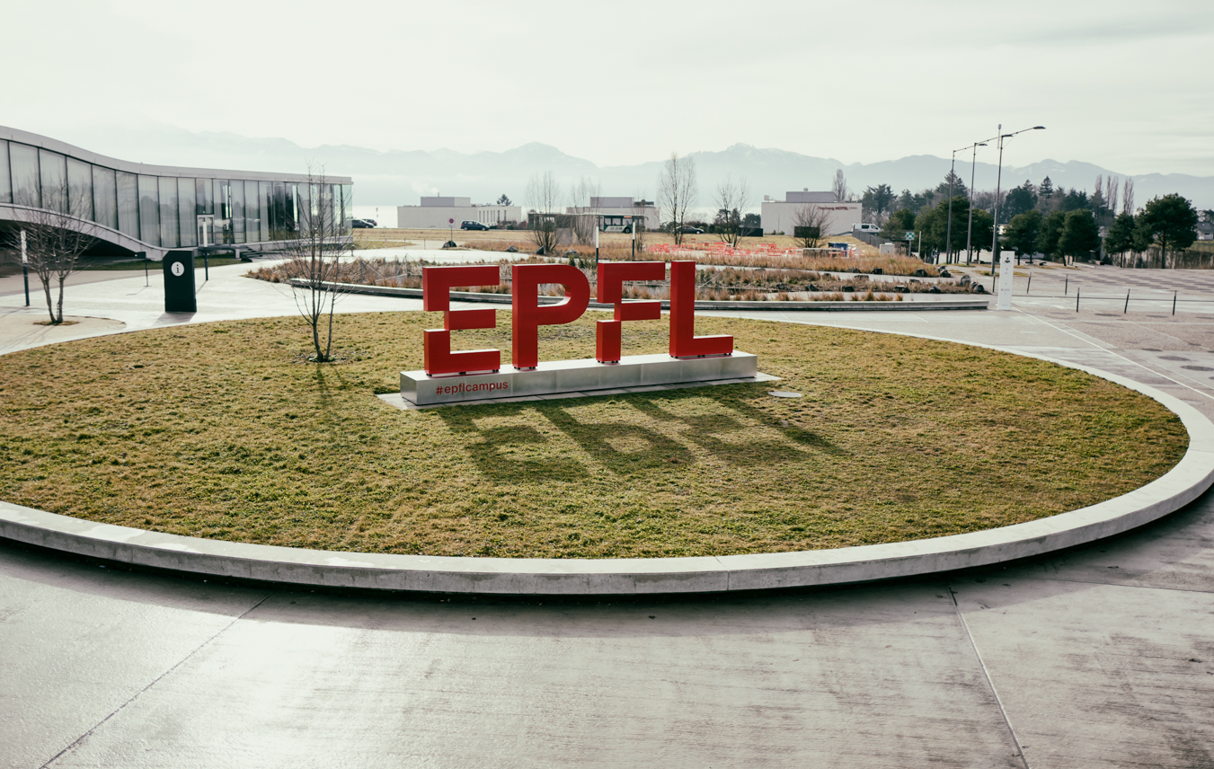
Questions?
Vincent Gardeux

Slide 39
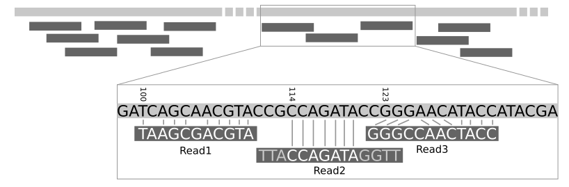

Preprocessing: Mapping to genome/transcriptome
Short reads are efficiently mapped to the genome or transcriptome using short read aligners and known genomic annotations (e.g. Ensembl or UCSC)
RNA-seq raw reads
Mapping to reference genome
Mapped reads
Galaxy tutorial
Efficient alignment with specialized tools
Large number of aligners available
(>70 on Wikipedia 20.02.2022)
Considerations: accuracy, gap-aware, speed, memory, …
Tools:
BWA
Kallisto
STAR
Now STARsolo is specifically designed for single-cell and multiplexed exp.

Slide 40
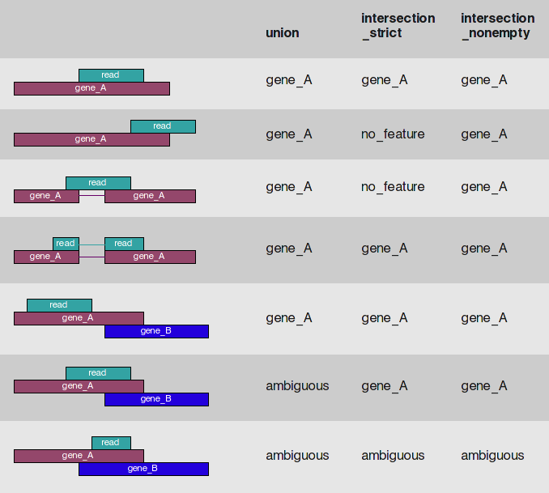
Preprocessing: Gene expression estimate – count matrix
Expression is summarized as read abundance per genomic feature (gene, transcript, exon)
Note: The assignment of reads to genes can be challenging due to overlapping annotation
Arbitrary decisions need to be made for dealing with reads spanning multiple features
Different tools, different results
 | Cell 1 | Cell 2
Gene A | 5 | …
Gene B | 2 | …
Gene C | 6 | …
Gene A
Gene B
Gene C
Read count
matrix
HTseq (AndersHuberBioinformatics2014)

Slide 41
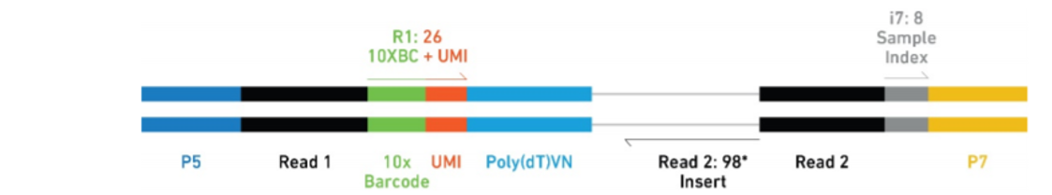
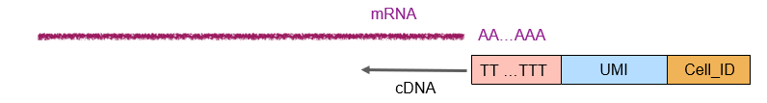
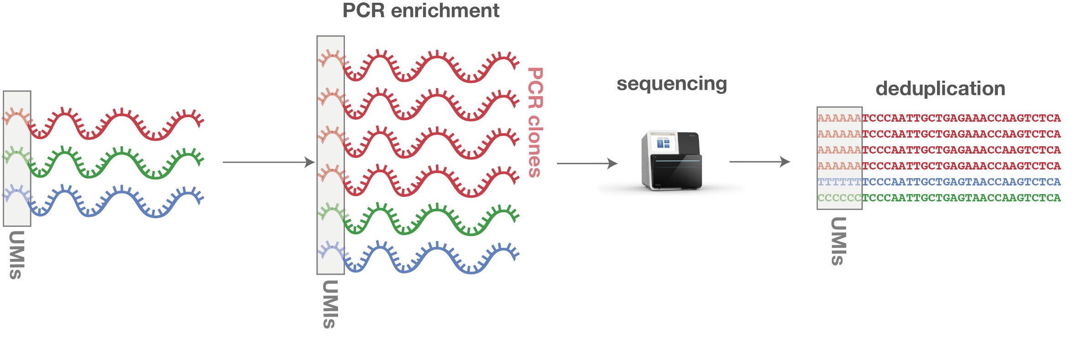
Unique Molecular Identifier (UMI) – Principle
UMIs are random sequences that are attached to the fragments prior amplifications
They are used to remove the amplification bias, after sequencing
“Original unique” transcripts can thus be detected in the final output by removing the duplicated UMI sequences
Reduce the amplification bias
Better approximation of duplicates as compared to standard Picard/Samtools tools estimation
6 identical sequences
3 unique input fragments
© ecSeq Bioinformatics

Slide 42
Unique Molecular Identifier (UMI) – Example
Same example than before. Now the reads are colored by unique UMI sequence
 | Cell 1 | Cell 2
Gene A | 5 | …
Gene B | 2 | …
Gene C | 6 | …
Gene A
Gene B
Gene C
Read count
matrix
 | Cell 1 | Cell 2
Gene A | ? | …
Gene B | ? | …
Gene C | ? | …
UMI count
matrix?

Slide 43
Unique Molecular Identifier (UMI) – Example
Same example than before. Now the reads are colored by unique UMI sequence
 | Cell 1 | Cell 2
Gene A | 5 | …
Gene B | 2 | …
Gene C | 6 | …
Gene A
Gene B
Gene C
Read count
matrix
 | Cell 1 | Cell 2
Gene A | 4 | …
Gene B | 2 | …
Gene C | 4 | …
UMI count
matrix
Also need to account for sequencing errors in the UMIs
Allow mismatches
Collapse barcodes with “similar enough” UMIs

Slide 44
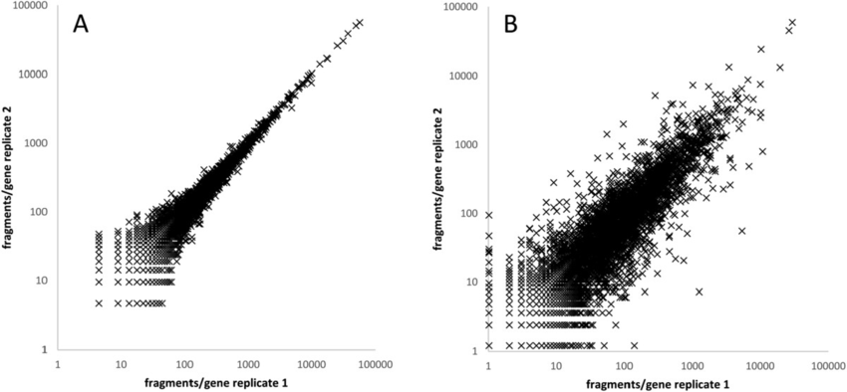
Bulk RNA-seq, technical vs biological variation
Technical replicates are usually very well correlated for bulk RNA-seq.
Biological reps a bit less, but it’s expected
Technical replicates Biological replicates
R²≃1
R²≃0.8
Landstorfer et al, BMC Genomics (2014)

Slide 45
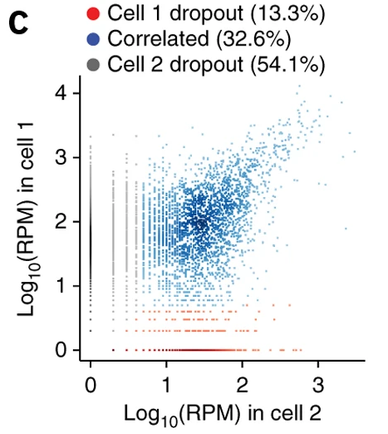
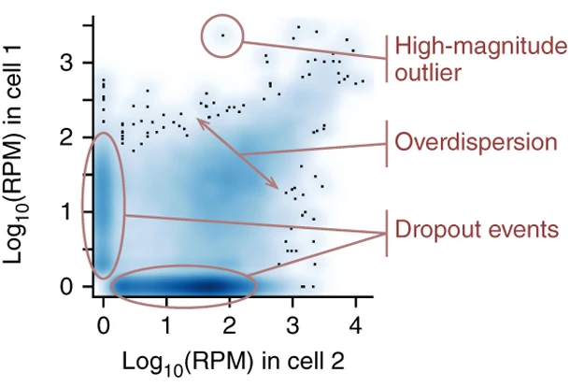
Single-cell RNA-seq – variation and dropouts
Cell 1 dropouts
Cell 2 dropouts
2 cells of the same cell-type:
Mouse Embryonic Fibroblast (MEF)
Kharchenko et al., Nature (2014)

Slide 46

Dropouts, what to do?
There was a long debate about what is the best solution for dealing with drop-outs
Nowadays, apart from very specific analyses, we don’t do anything special about dropouts. We just keep in mind that they are present in the data

